Slide 1

Fintech Society
BLOCKCHAIN &
Cryptocurrency
WORKSHOP
Notes:
Drag & Drop directly images here on placeholder. OR right click on grey rectangle and send to back, now you are able to see the image placeholder. Click on it and place your image. After that right click on this again and send it to back of the page.

Slide 2





Our Powerful Team
Antreas Pogiatzis
Santiago Ramirez
B.Sc Software Engineering
LL.M. in Corporate and Financial Law
Kamal Chauhan
Aleksandra Waluga
Zi Qin Wong
B.Acc. Accounting & Finance
B.Acc. Accounting & Finance
M.A. Social Sciences

Slide 3

BLOCK
CHAIN

Slide 4
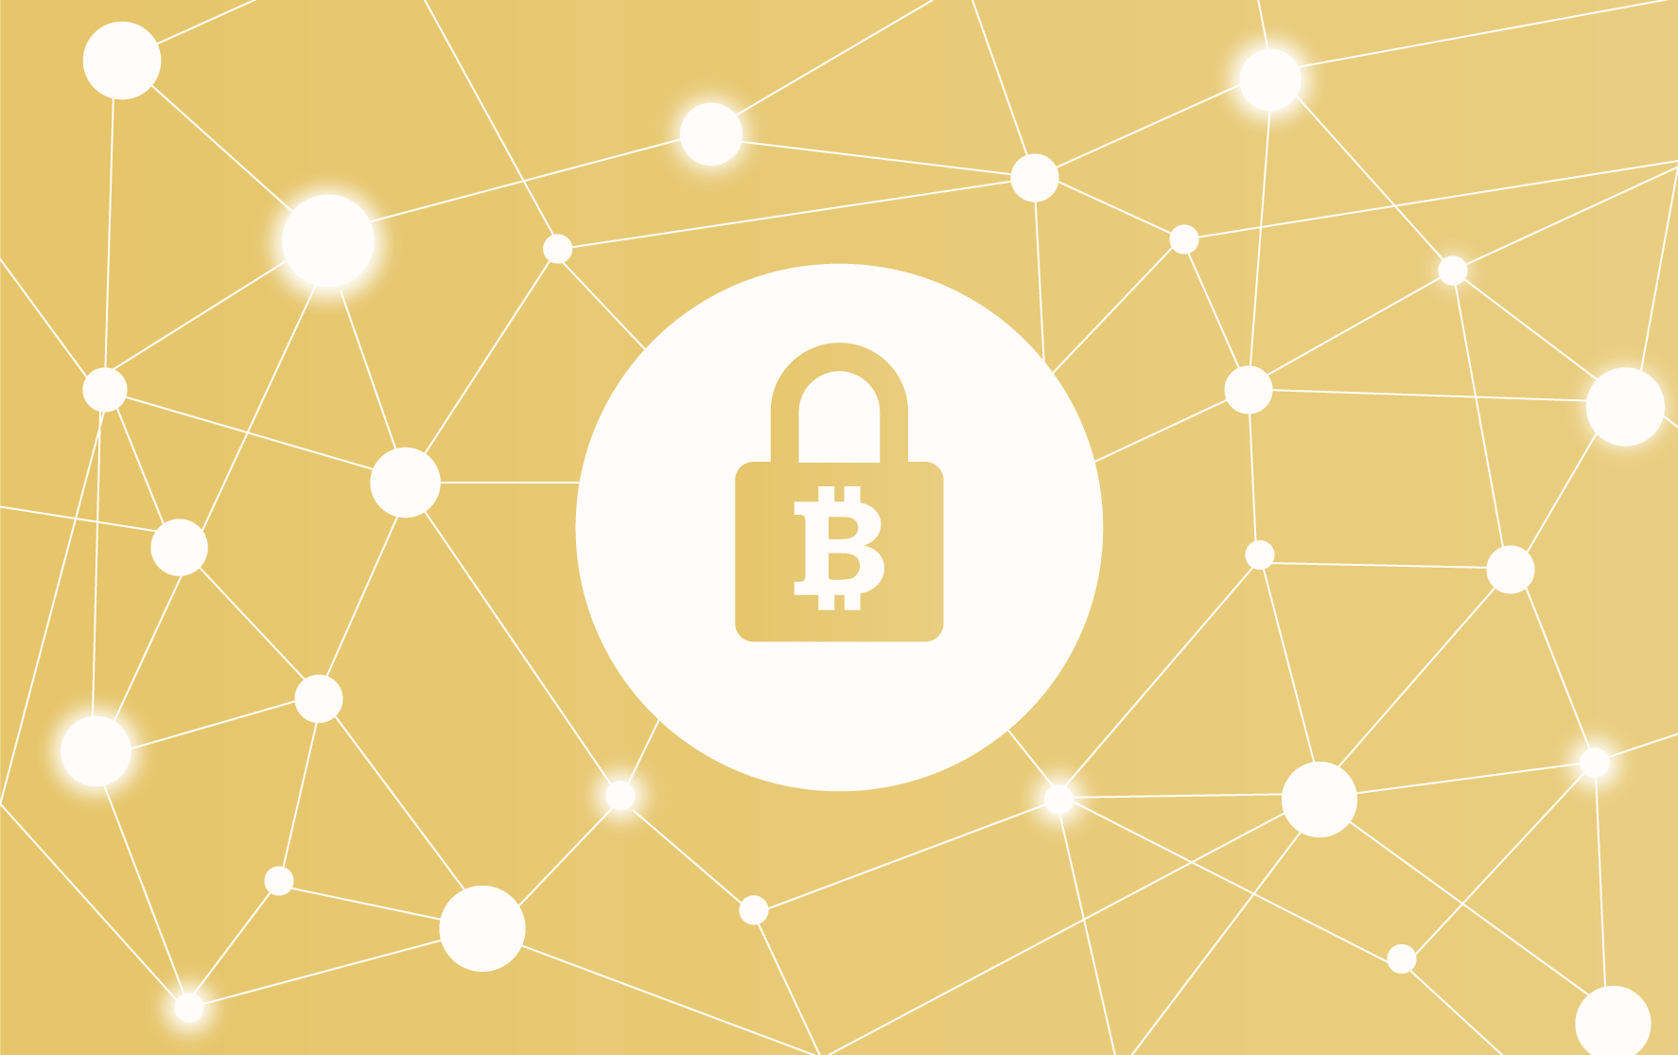

HISTORY OF BLOCKCHAIN
Blockchain was first invented by Satoshi Nakamoto when he published the Bitcoin paper in 2009. It stayed under the radar for 6 years probably due to its bad reputation. Initially, Bitcoin was the money of the dark web and since Blockchain was closely associated with Bitcoin it inherited the same name. Nevertheless, recently many individuals and corporations identified its potential and new novel applications started to emerge which could dramatically disrupt many traditional industries.

Slide 5

LEDGER
A LEDGER IS A LIST OF INGOING AND OUTGOING TRANSACTIONS OF AN ACCOUNT IN CHRONOLOGICAL SEQUENCE TO KEEP TRACK OF THE BALANCE.

Slide 6


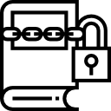

Blockchain Components
1. Each block contains a list of transactions. Just like a ledger
2. Every block has an identifier which is based on the block contents (hash).
3. Blocks in the chain have a reference to the previous block ( except the genesis block )
4. Apart from the list of transactions there are several other properties in each block which are mainly used for technical purposes. ( i.e. nonce )
Ledger
P2P Network
Cryptography
Consensus Algorithm

Slide 7
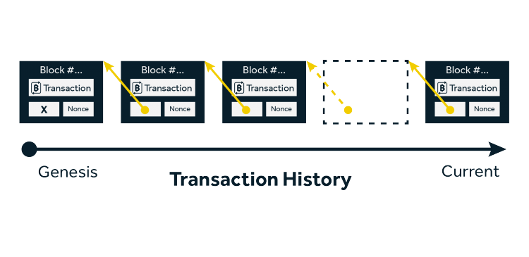
Blockchain 101
THE BLOCK
1. Each block contains a list of transactions. Just like a ledger
2. Every block has an identifier which is based on the block contents (hash).
3. Blocks in the chain have a reference to the previous block ( except the genesis block )
4. Apart from the list of transactions there are several other properties in each block which are mainly used for technical purposes. ( i.e. nonce )
Source: https://graquantum.com/blog/introduction-bitcoin-blockchain/

Slide 8
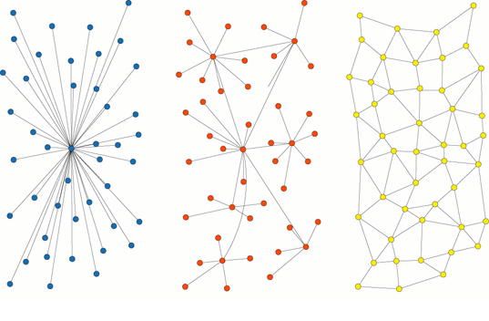
Blockchain 101
THE NETWORK
1. A blockchain network is comprised of nodes which are interconnected.
2. Each Node is a device running a client software which most often is responsible for validating, storing and distributing transactions.
3. This distributed architecture provides robustness, high availability disintermediation and security.
CENTRALIZED
DECENTRALIZED
DISTRIBUTED
Firstly illustrated by Paul Baran in 1962 to his paper, On Distributed Communications

Slide 9
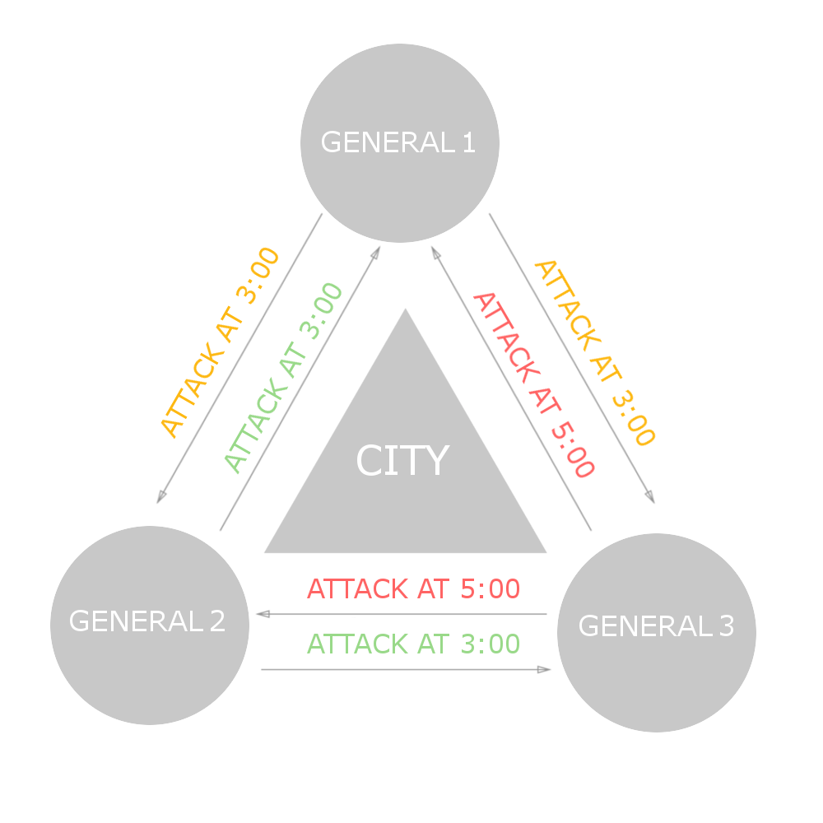
Blockchain 101
BYZANTINE’S GENERAL PROBLEM
THE CONSENSUS
1. Consensus algorithms are used by each node to validate and order transactions properly.
2. Most often the consensus algorithm used can directly affect the speed of the network.
3. Bitcoin uses the Proof-of-Work consensus algorithm which was invented by Nakamoto.
Described by Leslie Lamport, Robert Shostak and Marshall Pease in their 1982 paper, "The Byzantine Generals Problem"

Slide 10
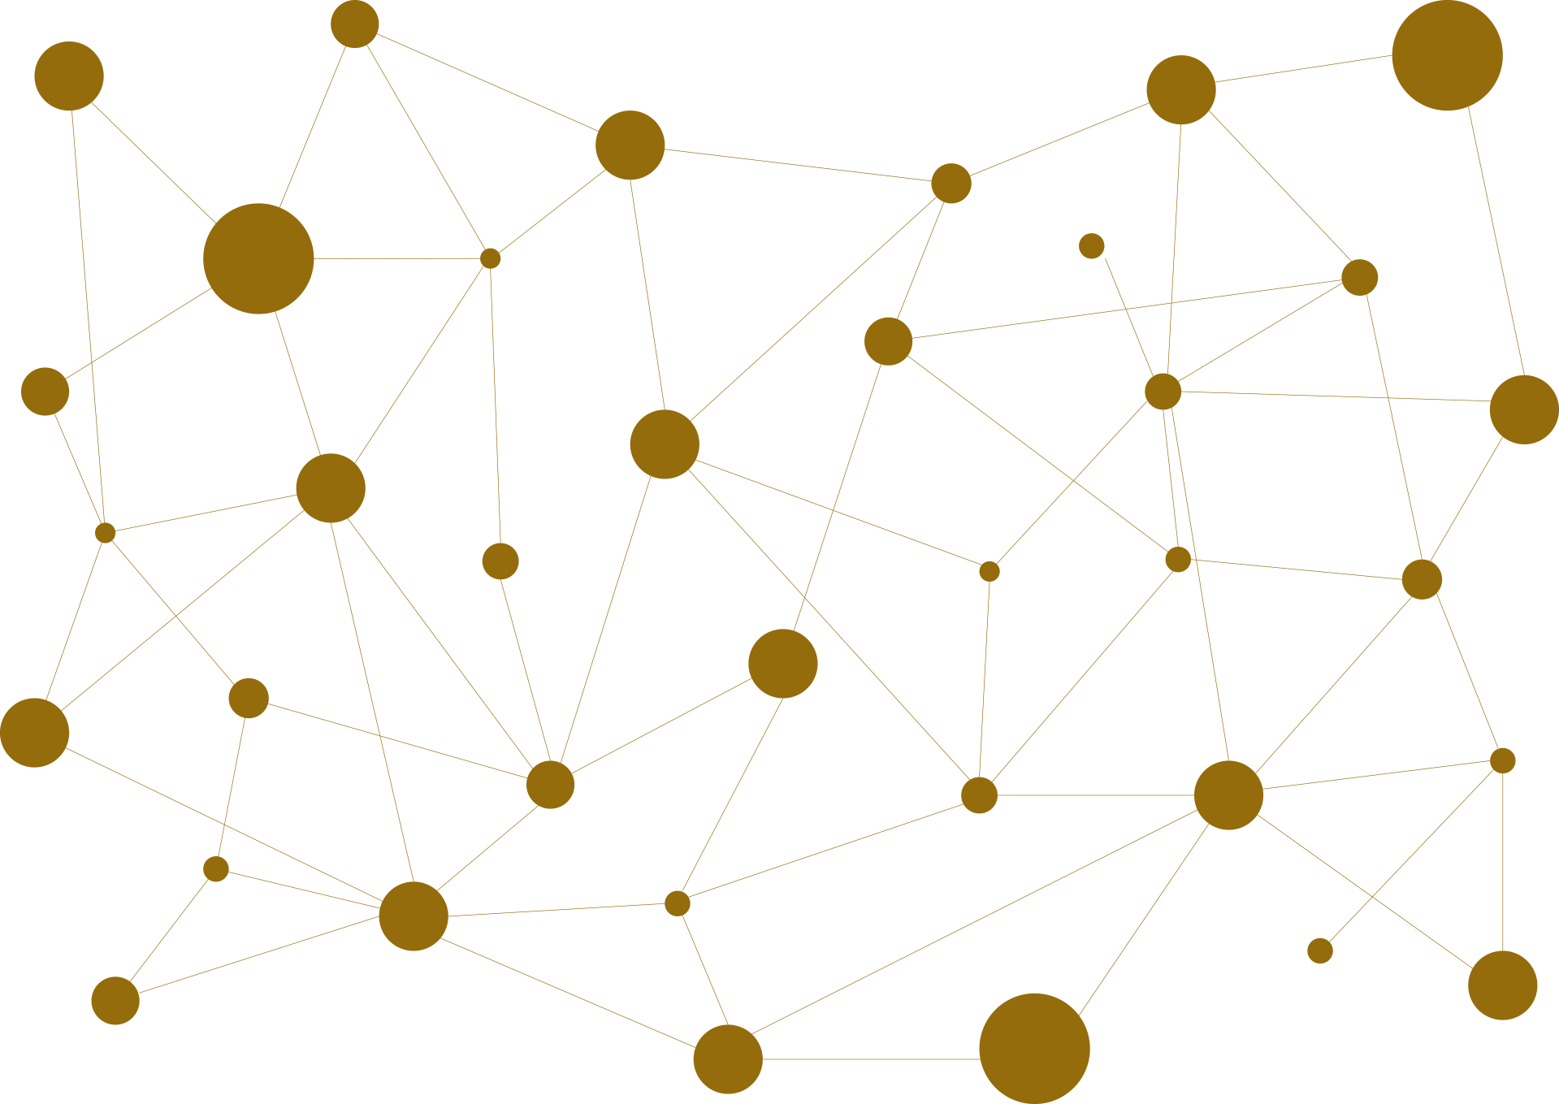
Blockchain
P2P network which utilises cryptography and consensus algorithms to distribute and validate transactions on a shared ledger.

Slide 11




Industry Disruption
SUPPLY CHAIN
HEALTHCARE
FINTECH
CIVIC

Slide 12
CRYPTOCURRENCIES
05.
Bitcoin
01.
Cryptography
A short introduction
What is it?
06.
The History of Bitcoin
02.
Asymmetric Cryptography
How has it grown?
How does it work?
07.
Other Cryptocurrencies
03.
Cryptocurrencies
What else is there?
A simple definition
08.
Their Potential
04.
Cryptocurrencies
What’s good about them?
What are they?
09.
Their Downsides
What’s about about them?

Slide 13
Cryptography
What is it?
Key Words and Definitions
Cryptography: “the process of converting legible information into an almost uncrackable code, to track purchases and transfers” (www.telegraph.co.uk)
Asymmetric cryptography (public key cryptography): Using public and private keys to encrypt and decrypt information
Public key: A ‘key’ made up of a large number that is made available to all users. Encrypts information
Private key: A unique ‘key’ that is only available to one user. Decrypts information
Hash function: A mathematical algorithm that involves the use of keys to verify the legitimacy of a transaction

Slide 14
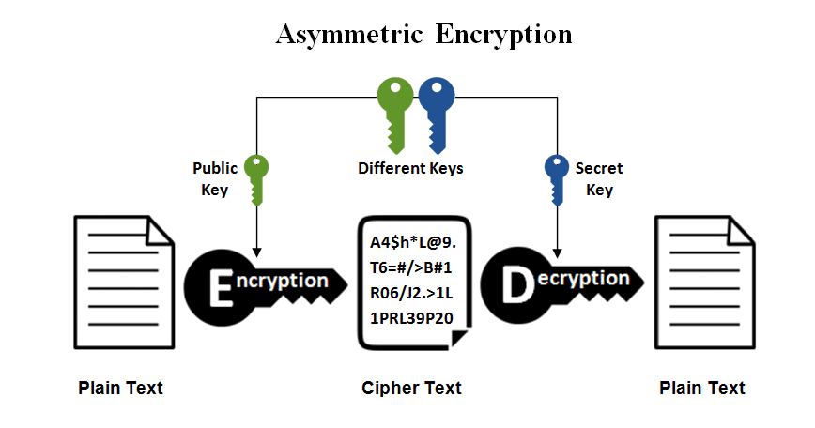
Asymmetric Cryptography
How does it work?
Message
One user sends an amount of currency to another
Private Key
Public Key
Encryption
The public key encrypts the information, and uploads it to the network
Decryption
The private key decrypts the message
Verification
The transaction is verified by many users, with the cryptographic hash function

Slide 15
Cryptocurrency
A DIGITAL CURRENCY THAT UTILIZES CRYPTOGRAPHY TO SECURE TRANSACTIONS AND CONTROL THE ISSUANCE OF NEW UNITS.

Slide 16
Cryptocurrencies
What are they?
Digital
Completely online, no physical product
Decentralized
No central system controlling the currency
Peer-to-peer network
All computers are connected and can share data
Cryptography
Ensure that transactions are secure and anonymous

Slide 17

Bitcoin
A short introduction
The first cryptocurrency to ever be created
Created by an anonymous user under the name Satoshi Nakamoto
The most popular cryptocurrency to date

Slide 18
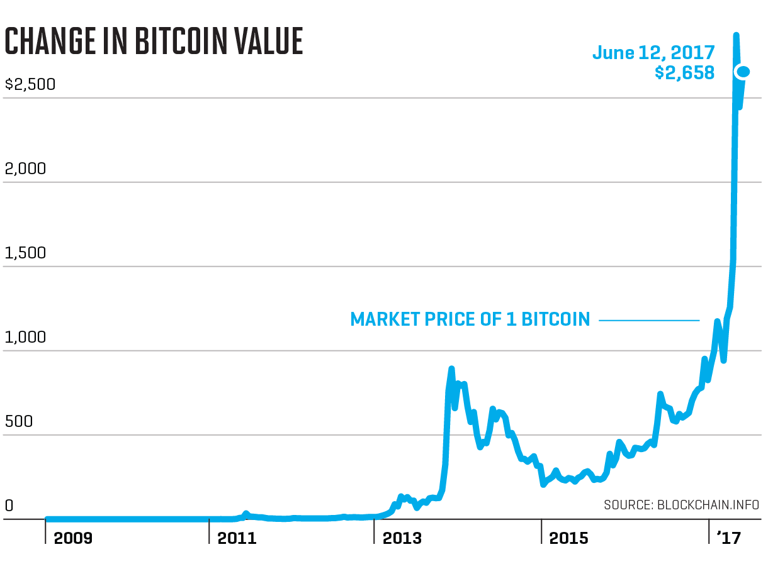
The History of Bitcoin
How has it grown?
October 31, 2008
The announcement of Bitcoin was made
January 3, 2009
The Genesis Block was created. This is the first block of transactions that all other subsequent blocks build upon
October 5, 2009
A currency rate is established for bitcoin at $1 = 1,309 BTC
February 6, 2010
The bitcoin economy is now worth $1 million
April 23, 2011
The value of Bitcoin is now on par with the Euro and British pound
June 12, 2011
The The Great Bubble of 2011 where the exchange rate dropped from US$31.91 to $10 in four days
May 9, 2012
An FBI report is leaked, showing concern that bitcoin is used for illegal transactions
November 9, 2013
The bitcoin value surges from $125 in September to $1242
2016
Source: www.fortune.com
Bitcoin is the ‘best performing currency of 2016’, with a 126% increase in value over the year

Slide 19


Other Cryptocurrencies
What else is there?
Litecoin
Ethereum
Ripple

Slide 20
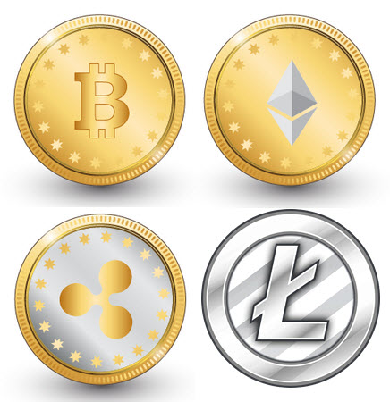
Their Potential
What’s good about them?
Secure and anonymous
Unaffected by inflation
Easy access and usage

Slide 21
Their Downsides
What’s bad about them?
External shocks
(price manipulation)
Illegal activity
Questionable legitimacy

Slide 22
SMART
CONTRACTS

Slide 23
What is a smart contract?
A smart contract is a computer program that can facilitate and enforce the terms of a contract, without the need for third party intermediaries.

Slide 24
Blockchain
Database
Shared

Slide 25
Blockchain + Smart Contract
Decentralised Application
Database
Shared

Slide 26



Benefits of Smart Contracts
1. A blockchain network is comprised of nodes which are interconnected.
2. Each Node is a device running a client software which most often is responsible for validating, storing and distributing transactions.
3. This distributed architecture provides robustness, high availability disintermediation and security.
Immutability
Security
Efficiency

Slide 27
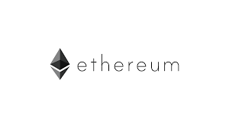




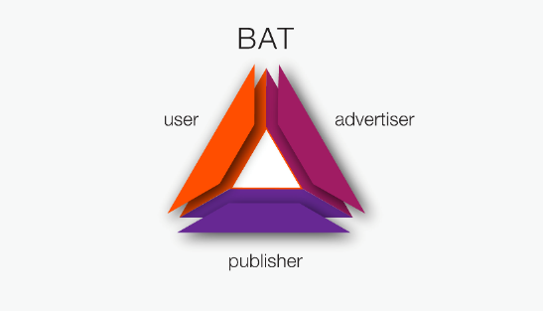
Ethereum and ERC20 Tokens
$737 m
$710 m
$179 m
$157 m
$133 m
Disruption is coming – but not tomorrow
“99% of ICO’s are hype…the technology is years behind” Andreas Antonopolous

Slide 28
Real World Uses
Supply Chain
Property
Management
Voting systems

Slide 29
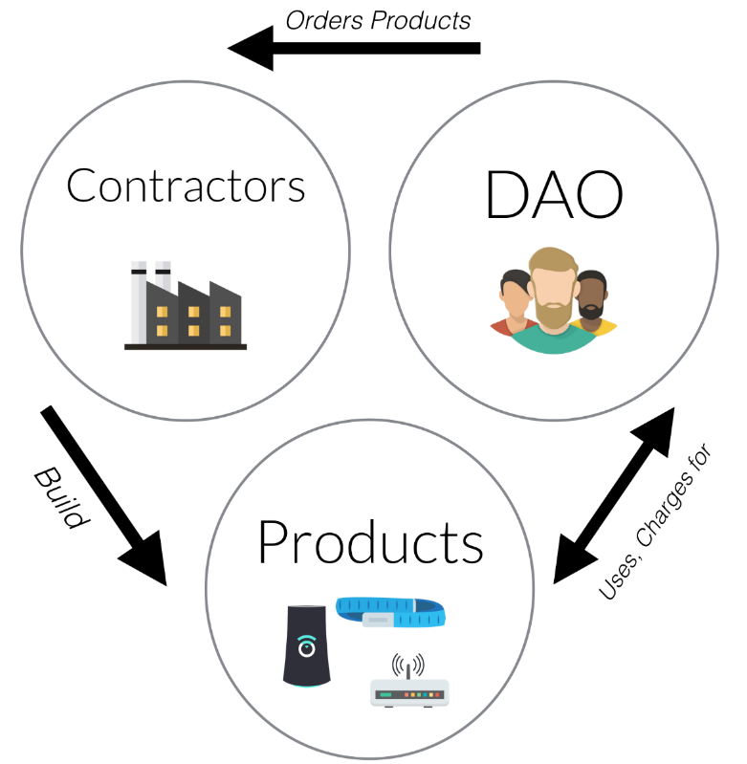
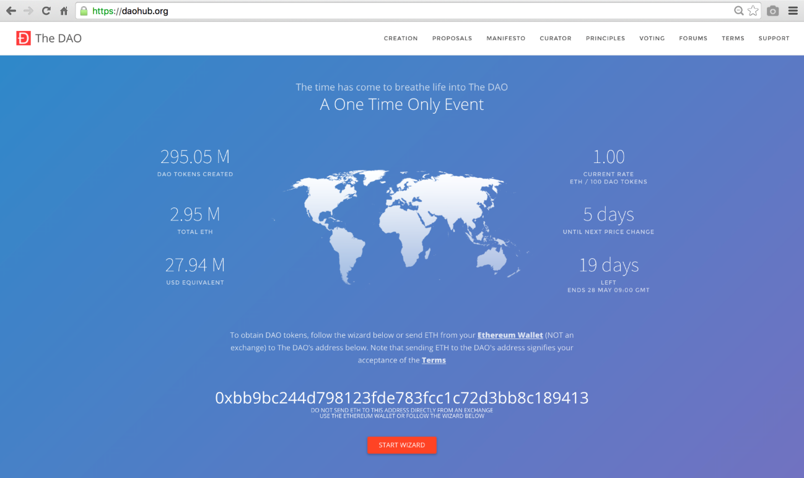
Decentralised Autonomous Organisations and “The DAO” hack
Companies or funds
without traditional managers
“The DAO” 2016 hack

Slide 30
Initial
Coin
Offerings

Slide 31
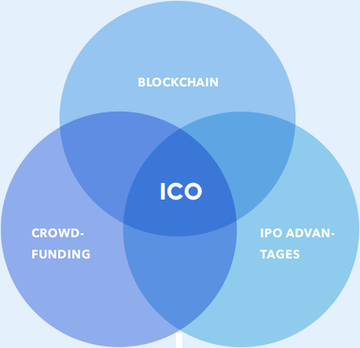
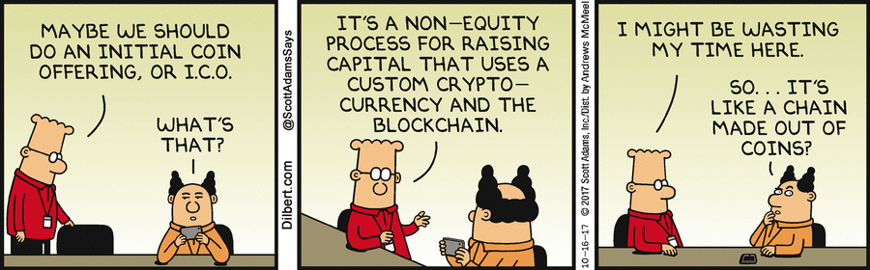
Kickstarter for Crypto-Nerds
ICO = Initial Coin Offering
issue digital tokens and sell them to a global crowd; receive cryptocurrency or regular money in return
allows to crowdfund projects that struggle to win VC’s backing

Slide 32
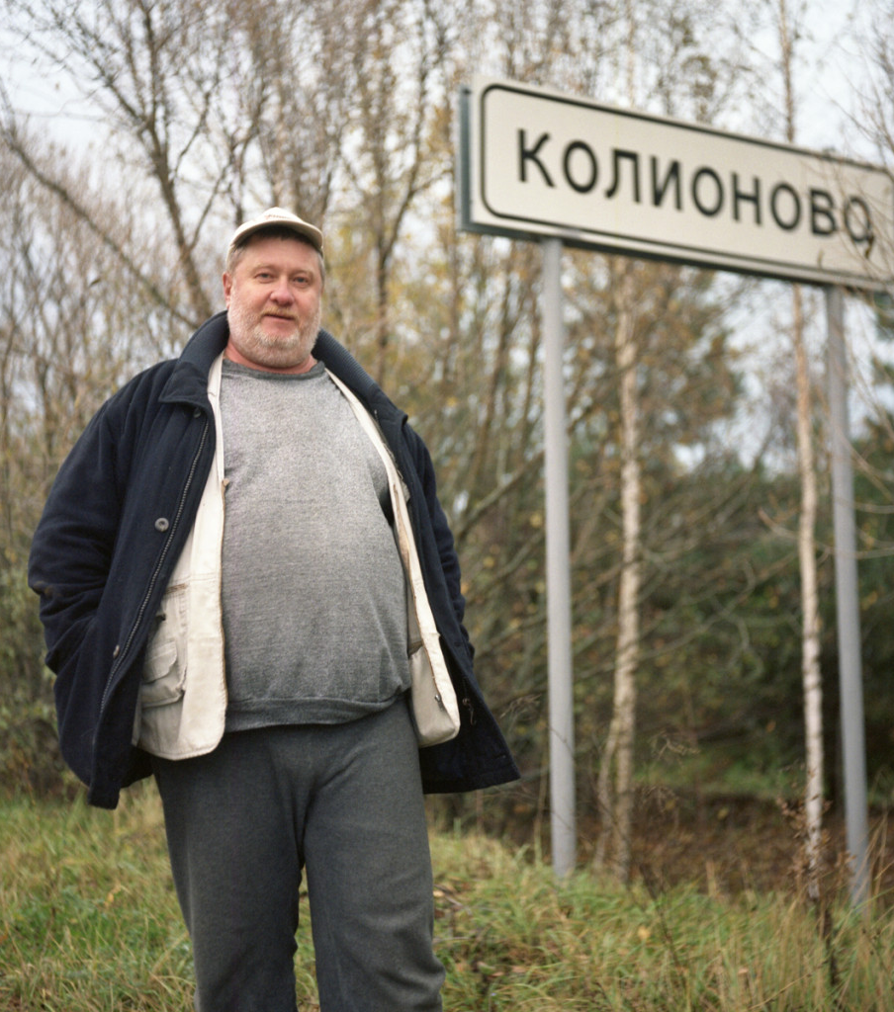
Monopoly Money?
ICOs may seem like they sell only a promise of hypothetical future piece of code
in reality – sold with smart contracts, i.e. codified terms of trade
entitle to a share of profits, platform utility, even real products
tokens nature attract a great deal of value speculation

Slide 33
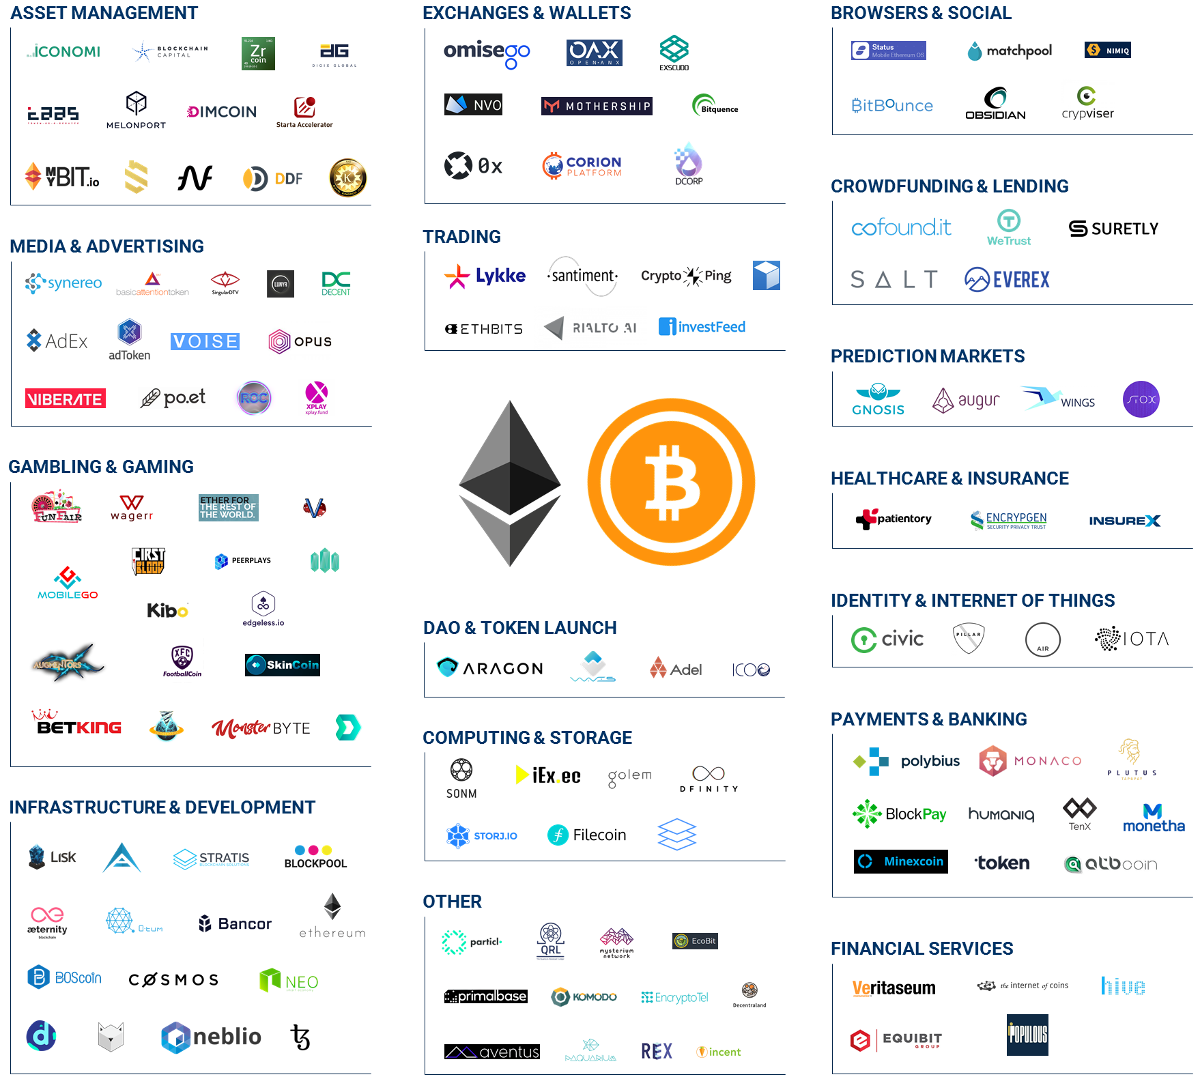
ICO Speculative Frenzy
$1.3B raised in just the 1st half of 2017
many successful ICOs, some raising >$150M: Filecoin, Tezos, Bancor, DAO
investing in tokens’ potential appreciation
reflection of the wider financial markets pressures?

Slide 34
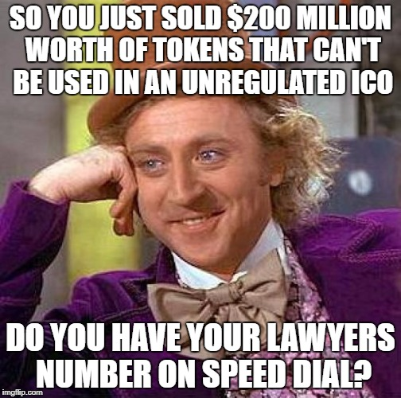
90’s Are Back
ICO craze reminiscent of 90’s dotcom era
soaring valuations followed by a collapse caused many investors to lose large sums of money
40% fraudsters, 50% not familiar with blockchain technicalities, 9% oblivious to business issues
the hopeful 1% may become the new Google, Amazon, PayPal

Slide 35
WORK
SHOP TIME

Slide 36

REGULATION
Overview of the current regulation regarding ICOs & cryptocurrencies.
China’s ban & SEC’s regulation.
The two largest economies and their diametrically opposed approach of the question.
A legal no man’s land.
Why regulation is necessary ?
The Japanese example to introduce regulation.
Few consequences due to the lack of rules.
How Japan managed to establish a legal framework for ICOs and cryptocurrencies.
ICOs that went wrong.
Optimism for a future regulation.
Could regulation prevent these incidents?
Why regulation is such a complex task?
Why should we remain optimistic for a (positive) regulation?

Slide 37
Overview of regulation
Legal (or partially legal)
No legal provision make ICOs, cryptocurrencies and exchanges illegal, which automatically
make them legal. “Partially legal” means that only the purchase of good or services with cryptocurrencies is not permitted.
Sometimes, a “legal status” has been given to them (securities, foreign currency, commodities …). However, it doesn’t mean that a legal framework have been establish.
Regulatory framework
Regulatory provisions regarding specifically cryptocurrencies, ICOs, blockchain or fintechs have been adopted.
Ban policy
ICOs, cryptocurrencies and exchanges are subject to hostile policies or prohibiting rules.

Slide 38


A complex situation for regulators
Country | Private owning of cryptocurrencies | Platforms of exchanges (conventional currencies or other cryptocurrencies) | Payment (for goods or services) | ICOs | Mining
Philippines |  | Controlled by the Central Bank through licenses
Abu Dhabi emirate | Commodities | Regulated by the FSRA if the tokens issued have the characteristics of a security. |  | Regulated if the token is deemed as a security.
Russia
Venezuela

Slide 39
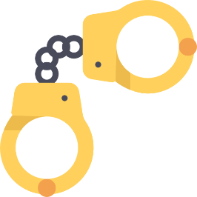
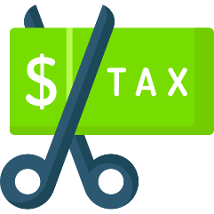


Why do we need a regulatory framework ?
Prevent criminal activities
Frauds, money laundering, illicit trafficking, terrorism, darknet markets …
Prevent tax evasion
The decentralized system of blockchains eases tax evasion. There is also a loss of earnings for states in terms of VAT.
Provide protection for investors
Regulation enables to …
With no legal framework, investors and cryptocurrencies-holders are less protected.
Enhance legitimacy and public’s trust
Regulation brings confidence and legitimacy, which ill develop the cryptocurrency market.

Slide 40
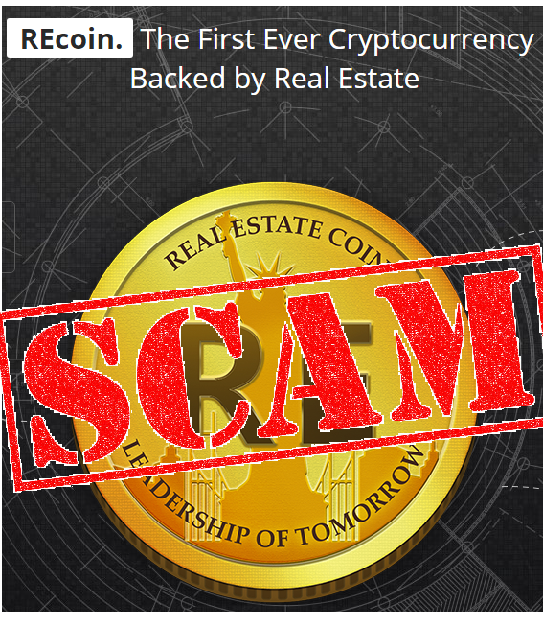


ICOs that went wrong
Could a regulatory framework prevent these incidents?
CoinDash
REcoin Group & DRC World
AirSwap
System hack
Technical issue
7 million USD loss in 30 minutes.
Ethereum sent to a fraudulent address after a smart-contract hijack.
Fraud
70,000 USD loss. (236 Ethereum coins)
The purchase of tokens during an ICO failed for an unknown reasons.
300,000 USD loss.
- No coins provided. - Misleading whitepapers.
- Violation of SEC’s registration requirements.

Slide 41


China’s ban & US’s attempt of regulation
 | Cryptocurrencies | ICOs
 | ‘Zero tolerance approach’ Owning cryptocurrencies is legal. Platforms of exchange are illegal and have been shutdown. | ICOs are illegal and deemed as “an unauthorized fundraising tool that may involve financial scam”.
 | Owning cryptocurrencies is legal. Platforms of exchange are legal but they may be subject to SEC’s requirement of registration if the tokens issued are deemed as securities. | ICOs are legal but the tokens issued may be considered as securities on a case-by-case basis, depending of ‘particular facts and circumstances’.

Slide 42

The Japanese example of regulation
Cryptocurrencies as a way of payment
They can legally be used to purchase goods or services. However, they are not a legal-tender currency.
Compliance to regulatory requirement
Reinforcement of the regulatory body
Platforms of exchanges are subject to various requirements (registration, minimum liquid capital, KYC procedures, annual audit …).
The Japanese Financial Services Agency set up a cryptocurrencies monitoring team to tighten controls.
Protection of clients
Information provided about the firm, cash and digital currencies not mixed together in the firm’s capital …

Slide 43


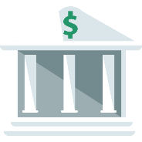

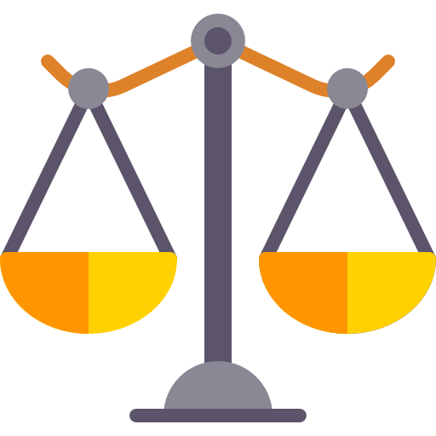



Why regulation is such a complex task ?
A wide range of factors must be taken into account for an efficient regulation
Intellectual property issues
Cross border transactions
Lobbying (from banks and other financial firms)
Difficult to understand for regulators
A consensus for a legal definition of cryptocurrencies
Decentralized and anonymous network
Conflict of jurisdiction among nations or regulators

Slide 44

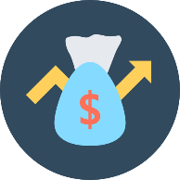

Optimism for a (positive) regulatory movement
… which justifies even more the call for a regulatory framework.
A permissive regulation will enable a better development of this technology.
The market is currently booming …
… which triggers regulators’ worries and interests.
Blockchain can be applied in other sectors than finance …

